Slide 1
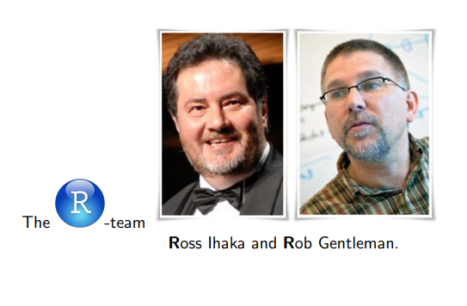


Slide 2
Getting Started with R and RStudio

Slide 3
To Install R and Rstudio on Windows
Download and Install R (Windows)
Download and Install RStudio
Download basic-miktex-22.7-x64

Slide 4
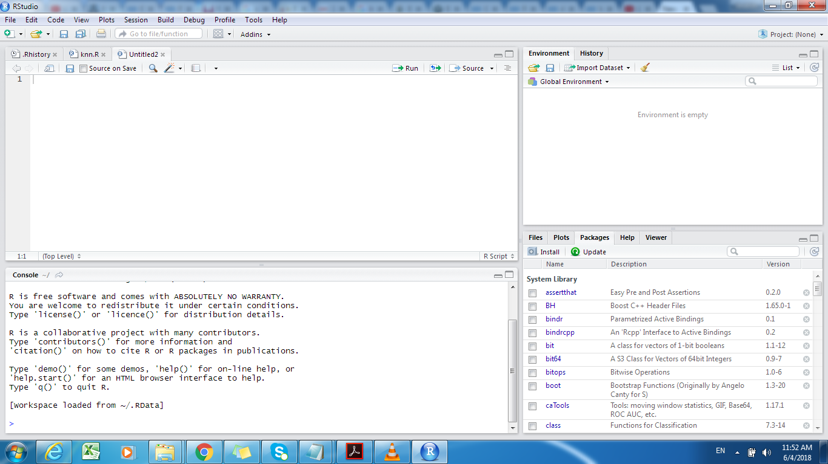
RStudio Working Area
R SCRIPT
Data Objects
CONSOLE (Script output panel)
File ,Plots, Package installation and Help panels

Slide 5
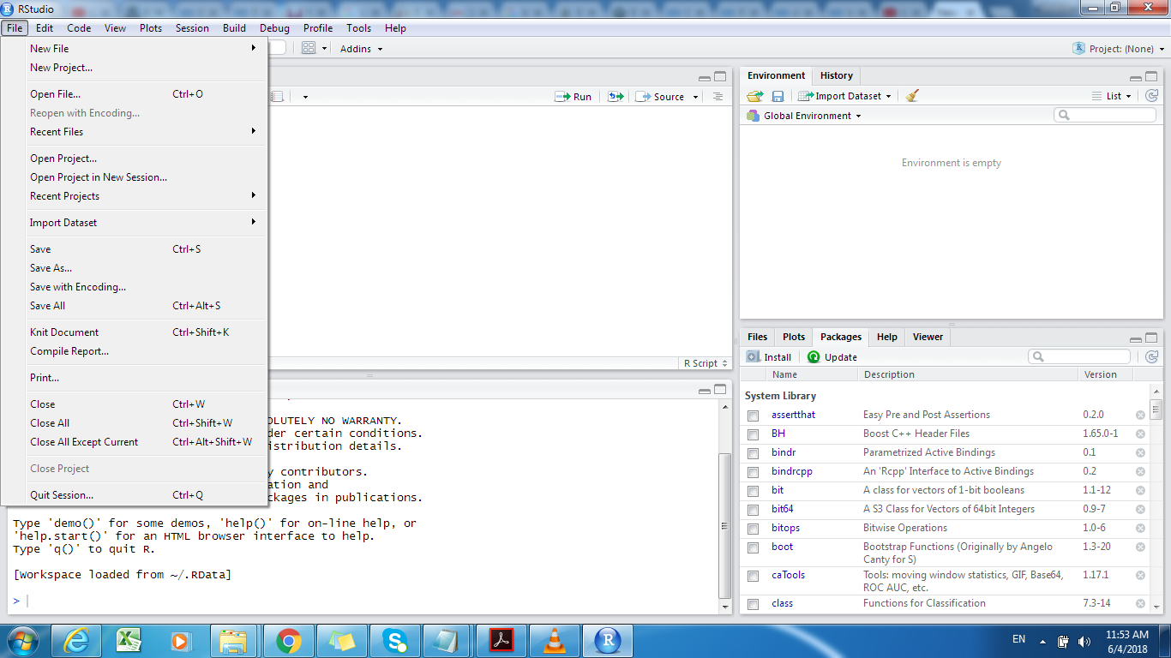
RStudio Working Area

Slide 6
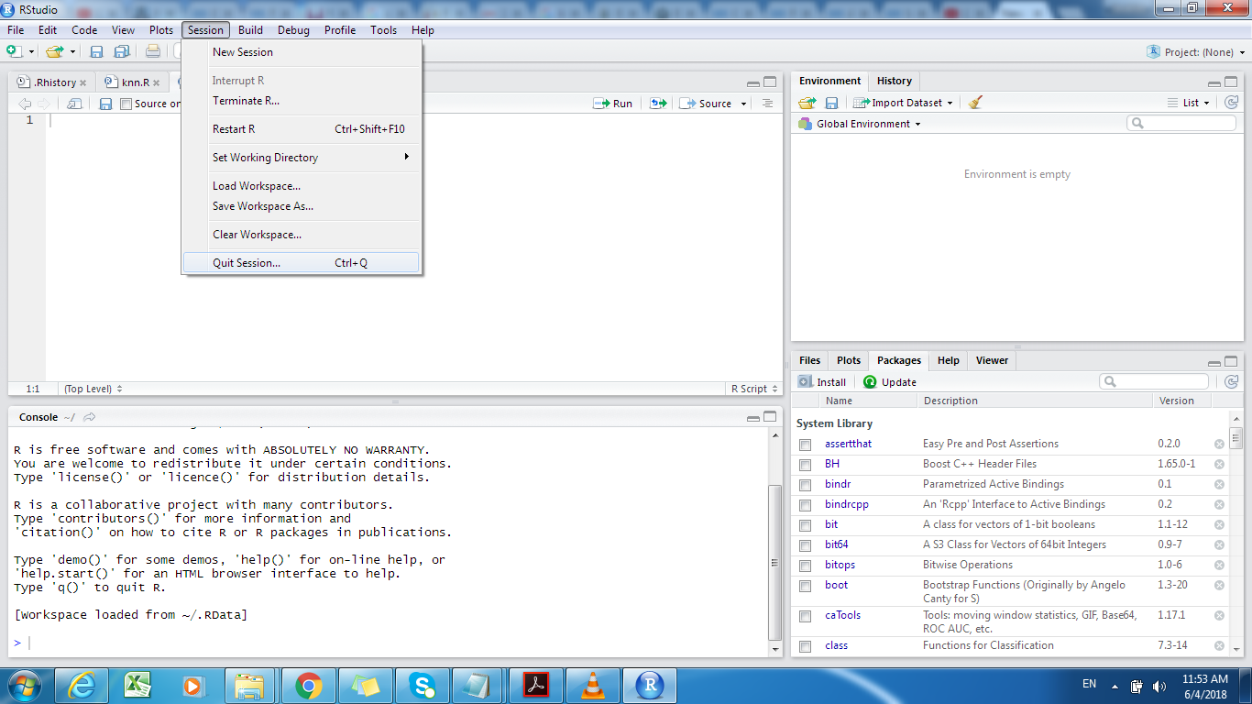
RStudio Working Area

Slide 7
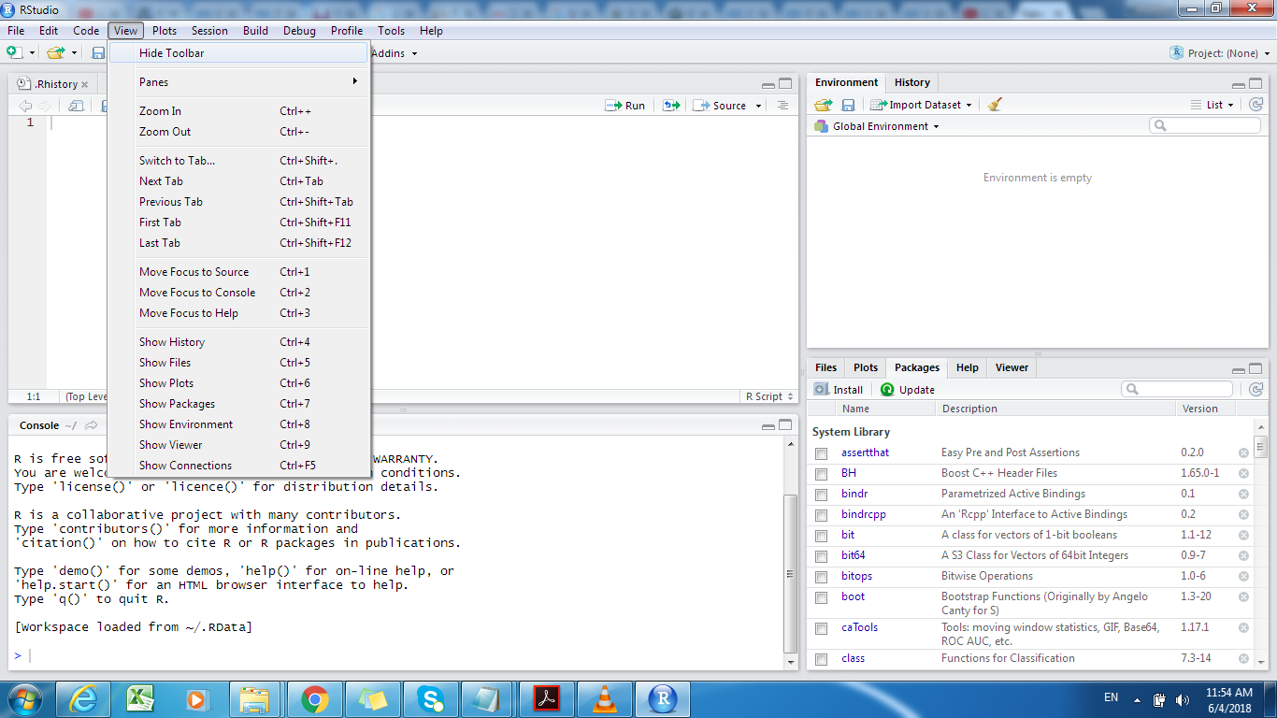
RStudio Working Area

Slide 8
Set working directory
getwd returns an absolute filepath representing the current working directory of the R process;
getwd ()
ls and objects return a vector of character strings giving the names of the objects in the specified
ls()
a character vector of full path names; the default corresponds to the working directory,
dir()

Slide 9
install.packages("knitr")
library(knitr)
install.packages("tinytex")
tinytex::install_tinytex()

Slide 10
Install packages to R
browseURL ("http://cran.r.project.org/web/view/")
browseURL ("https://cran.rproject.org/web/packages/available_packages_by_name.html")
install.packages("<the package's name>")
install.packages("ggplot2")
library("<the package's name>")
library("ggplot2")
search ()
?install.packages

Slide 11
Install swirl
The swirl R package makes it fun and easy to learn R programming and data science.
install.packages("swirl")
library("swirl")
swirl()
Swirl Courses Network
http://swirlstats.com/scn/title.html
swirl::install_course("R Programming")

Slide 12
Help
?`if`
?"if" # same
help("if") # same

Slide 13
LaTeX in RStudio
Research and Publication

Slide 14
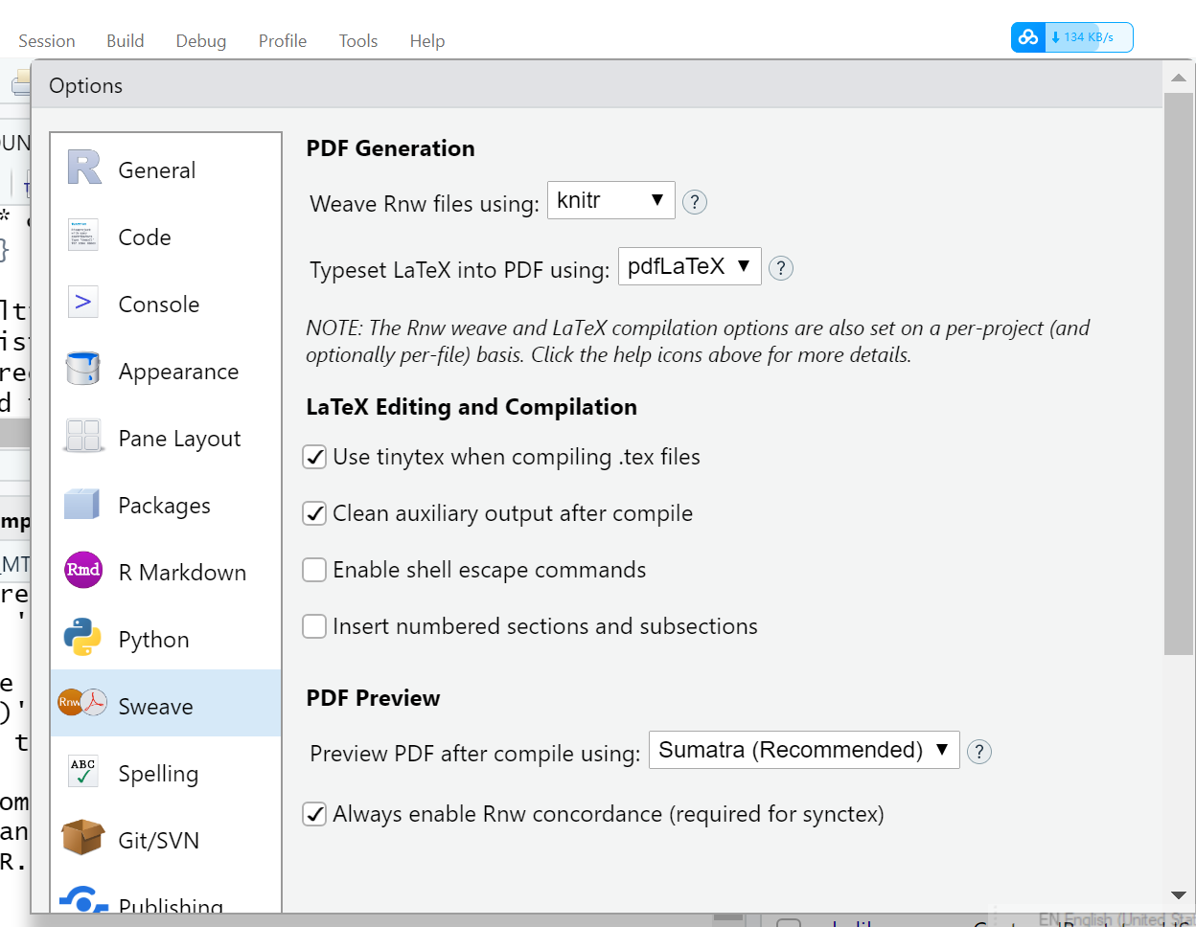
Install knitr
knitr is an engine for dynamic report generation with R. It is a package in the statistical programming language R that enables integration of R code into LaTeX, LyX, HTML, Markdown, AsciiDoc, and reStructuredText documents
Change sweave to knitr in global options
Create/Open R sweave/knitr file in RStudio - Rnw file
Write latex file in Rstudio, Rnw file

Slide 15
Example
\documentclass{article}
\begin{document}
Below is a code chunk.
<<foo, echo=TRUE>>=
z = 1+1
plot(cars)
@
The value of z is \Sexpr{z}.
\end{document}

Slide 16
Thank You
Q & A

